Slide 1



Python Day 2
Prepared by Isaac Kamau
+254704205553 |linkedin.com/in/isaak-mwangi/

Slide 2
In this session, we are shall be covering:
Python Line structure
Python comments
Python indentation
Python coding style

Slide 3
As you learn Python throughout this course, there are a few things you should keep in mind.
Python is case-sensitive.
Spacing is important.
Use error messages to help you learn

Slide 4
Python Indentation
Indentation refers to the spaces at the beginning of a code line.
Where in other programming languages the indentation in code is for readability only, the indentation in Python is very important.
Python uses indentation to indicate a block of code.

Slide 5
Python Comments
Comments can be used to explain Python code.
Comments can be used to make the code more readable.
Comments can be used to prevent execution when testing code.
#This is a comment

Slide 6
Multiline Comments
Since Python will ignore string literals that are not assigned to a variable, you can add a multiline string (triple quotes) in your code, and place your comment inside it:
""" This is a comment written in more than just one line """

Slide 7
Python coding style
To write beautiful python code we use PEP 8 Style guide formatting.
PEP 8, sometimes spelled PEP8 or PEP-8, is a document that provides guidelines and best practices on how to write Python code.
Read more about PEP 8 here:
https://peps.python.org/pep-0008/

Slide 8
Python’s Hello World
Python is an interpreted programming language, this means that as a developer you write Python (.py) files in a text editor and then put those files into the python interpreter to be executed.
Let's write our first Python file, called helloworld.py, which can be done in any text editor.
print("Hello, World!")

Slide 9
Python Variables
Variables:
Variables are containers for storing data values.
Creating Variables:
Python has no command for declaring a variable.
A variable is created the moment you first assign a value to it.

Slide 10
Example of a variable
x = 5 y = "John" print(x) print(y)

Slide 11
Many Values to Multiple Variables
Python allows you to assign values to multiple variables in one line:
Example
x, y, z = "Orange", "Banana", "Cherry" print(x) print(y) print(z)

Slide 12
Output Variables
The Python print() function is often used to output variables.
Example
x = "Python is awesome" print(x)

Slide 13
Python Operators
+ Addition
- Subtraction
* multiplication
/ division
% mod (the remainder after dividing)
** Exponentiation
// Divides and rounds down to the nearest integer

Slide 14
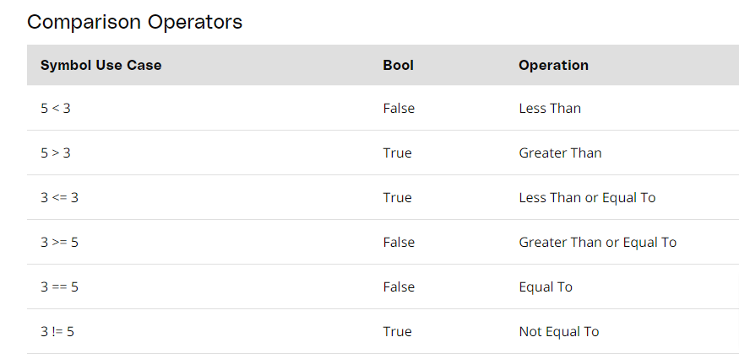

Slide 15
Strings
Strings in Python are shown as the variable type (str) You can define a string with either double quotes (“ “) or single quote (‘ ‘)

Slide 16
String Methods
Accessing Values in Strings
We use square brackets for slicing along with the index or indices to obtain a substring.
var1 = “MANU!"
var2 = "Software Testing"
print ("var1[0]:",var1[0])
print ("var2[1:5]:",var2[1:5])

Slide 17
Another Example
x = "Hello World!"
print(x[:6])
print(x[0:6] + “Manu")

Slide 18
Python String replace() Method
oldstring = 'I like python'
newstring = oldstring.replace('like', 'love')
print(newstring)

Slide 19
Changing upper and lower case strings
string="python at manu"
print(string.upper())

Slide 20
Using “join” function for the string
The join function is a more flexible way for concatenating string. With join function, you can add any character into the string.
For example, if you want to add a colon (:) after every character in the string “Python” you can use the following code.
print(":".join("Python"))

Slide 21
Reversing String
By using the reverse function, you can reverse the string. For example, if we have string “12345” and then if you apply the code for the reverse function as shown below.
string="12345"
print(''.join(reversed(string)))

Slide 22
Split Strings
Split strings is another function that can be applied in Python let see for string “guru99 career guru99”. First here we will split the string by using the command word.split and get the result.
word="guru99 career guru99"
print(word.split(' '))

Slide 23
To understand this better we will see one more example of split, instead of space (‘ ‘) we will replace it with (‘r’) and it will split the string wherever ‘r’ is mentioned in the string
word="guru99 career guru99"
print(word.split('r'))

